Slide 1


From Analysis of Information Needs towards An Information Model of Railway Infrastructure
23rd International Workshop of the European Group for Intelligent Computing in Engineering
Presenter: Zaharah Allah Bukhsh
Co-Authors: Timo Hartmann and Irina Stipanovic

Slide 2
Motivation
DESTination RAIL seeks to develop a decision support tool for the railway infrastructure managers.
A particular decision(e.g. maintenance decision) poses various types of data needs
Assets’ condition assessment data
Maintenance history
Network schedules
Others..
Notes:
If we consider only one decision that this decision support tool can support

Slide 3

Problem Context
Data is stored in separate database management system (e.g. CMMS, TCSS)
Challenge is to retrieve and process data from various systems with different data formats
There is a need to understand
What are those objects/domains about which data should be stored
What are the data needs of end-users
Decision Analysis?
Assets
Condition Data
Legacy DB
Operational
Data
Maintenance
Record
Source: (Thaduri et. al, 2015) (Moore and Starr, 2006)
Notes:
TCSS: traffic control and scheduling system
Before going in detail of data retrieval problem
Explain end-users
End-users are those that help in development of DST becauase they have domain knowledge as well as the main intended users

Slide 4
Information Modeling
Simplified representation
Structures the problem domain
Provide the semantic interpretation
Represent real-world objects
Represent abstract objects (e.g. concept, a group of persons or an individual)
Enable the active communication and involve the stakeholders (e.g. infrastructure managers, researchers, etc)
Source: (Turk, 2001)(Kent and Hoberman, 2012)
Notes:
Omit all the protocol and technical details
End-users can understand this model and can give us feedback

Slide 5
Objective
“Specify and understand the end-users’ data needs by identifying the railway network objects and their relationships
Notes:
End-users are people who will be using this system in form of providing the input during development phase.

Slide 6





Methodology
First version of Information Model
DESTination Project Proposal
Seminal Literature
Second version of Information Model
Questionnaire
Third version of Information Model
Interviews
Notes:
We developed IM in three iterative steps
We developed first version of IM by highlitening the names of railway objects menstioed in PP

Slide 7
Methodology
Questionnaire
5 text-questions about Railway Infrastructure
4 text-questions about data needs
Semi-structured Interviews
14 Participants, 9 Institutes, 8 countries
Varying focus from sub-soil assessment to life cycle costing

Slide 8
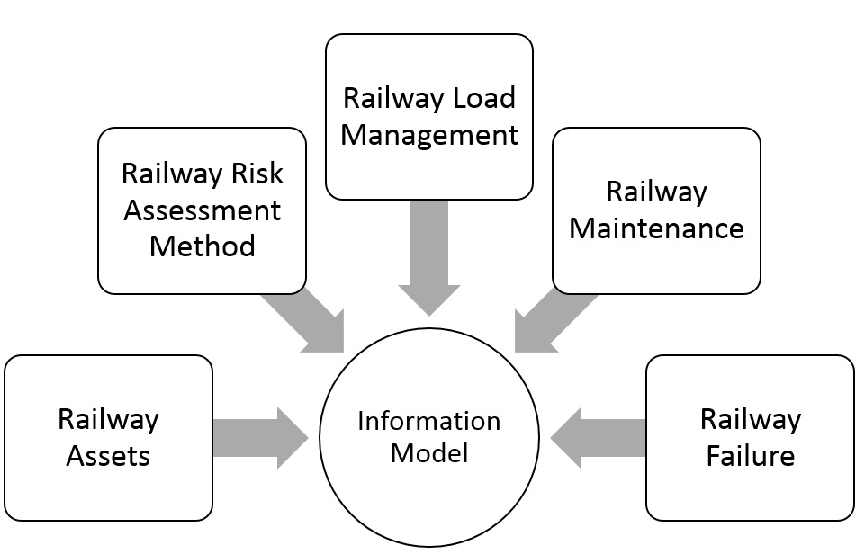
Domain of Railway Asset Management

Slide 9
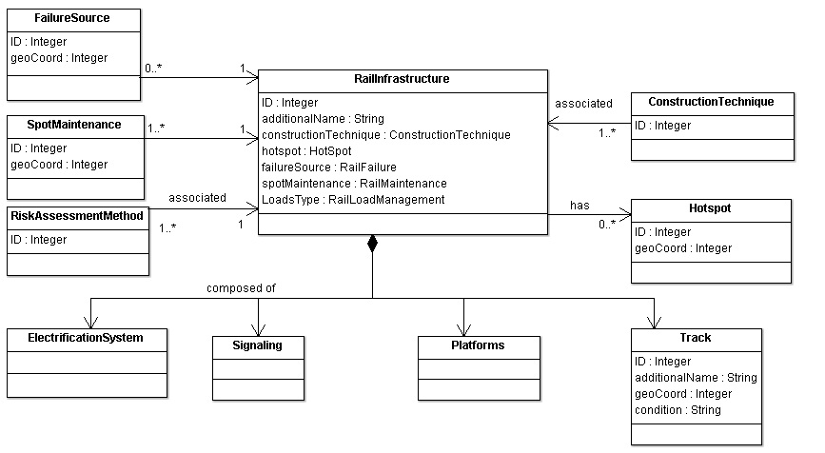
Information Model of Railway Asset Management

Slide 10
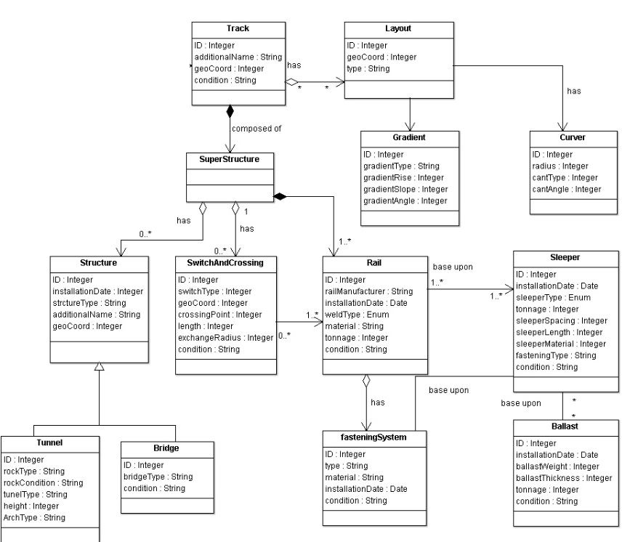
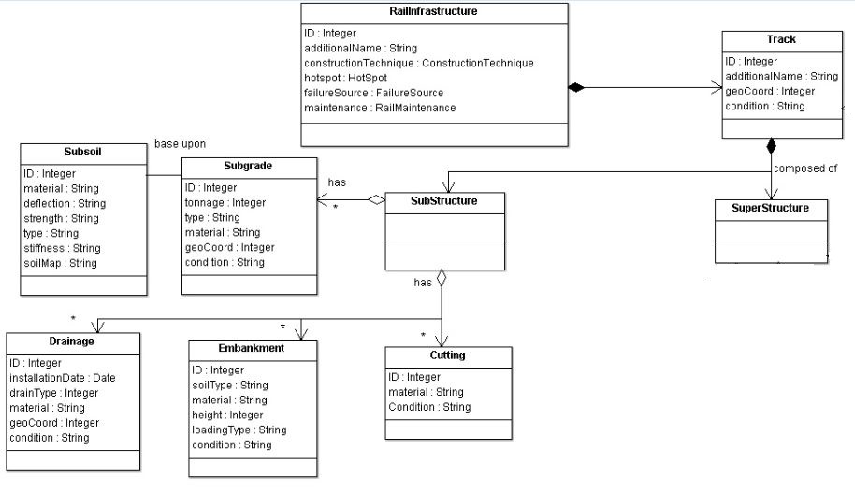
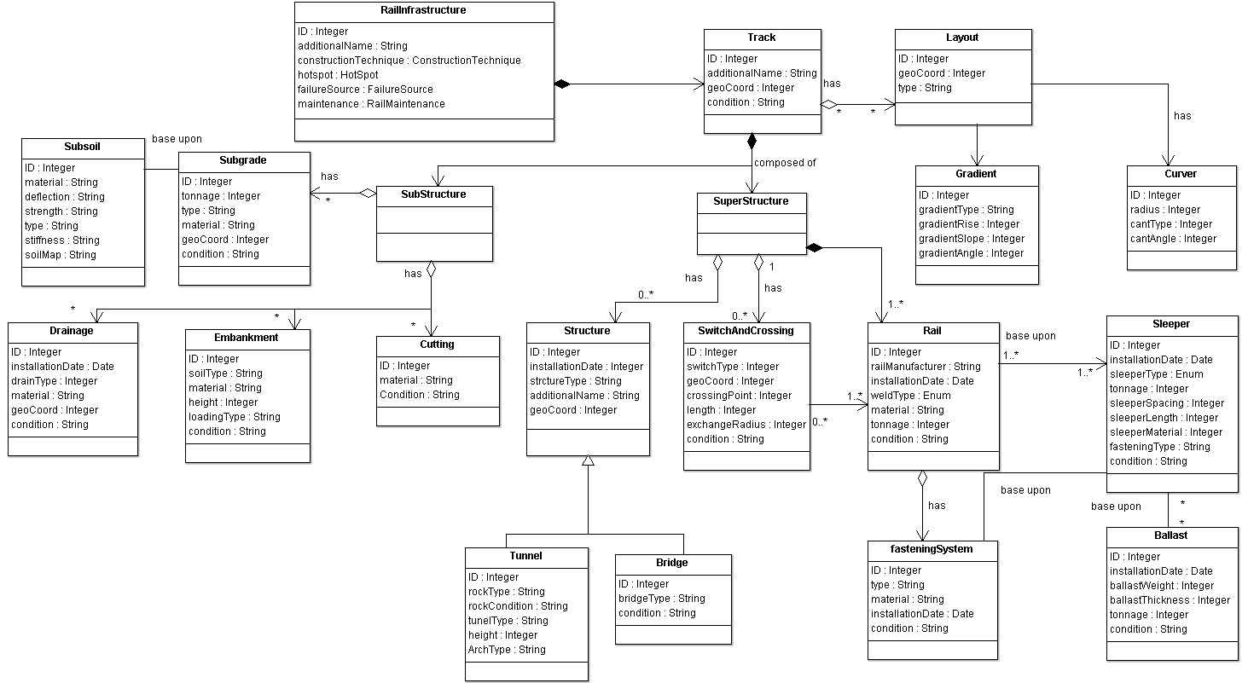
Information Model of Railway Infrastructure Assets

Slide 11
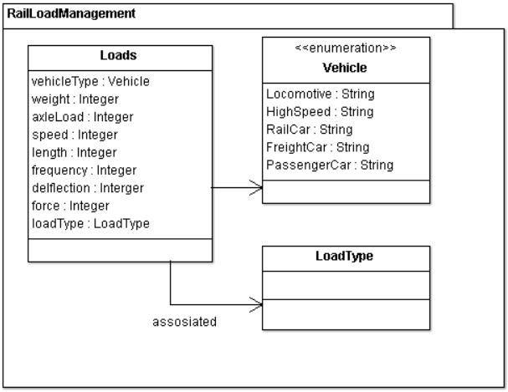
Information Model of Railway Load Management
Notes:
The purpose of railway load management is to store data about the different rolling stocks of the infrastructure.

Slide 12
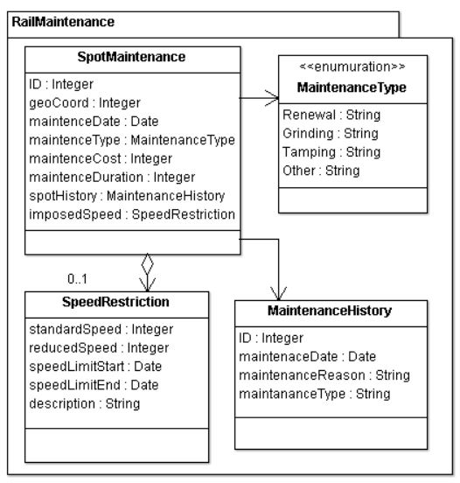
Information Model of Railway Maintenance

Slide 13
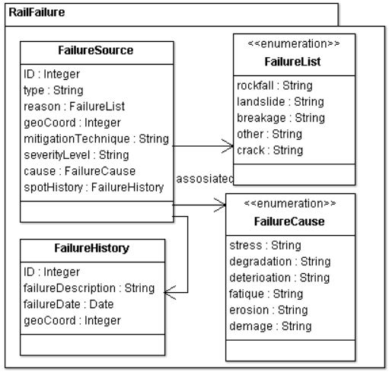
Information Model of Railway Failure

Slide 14
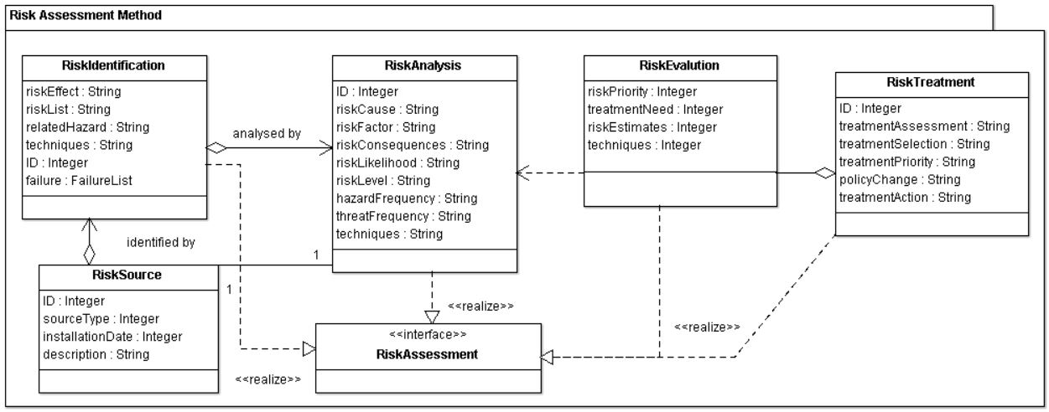
Information Model of Risk Assessment Method
Notes:
ISO 2009

Slide 15
Modeling Challenges
Level of Granularity
High granularity -> Complex information model
Low granularity -> too simple to represent problem domain
Decomposition
Changes
Source: (Kent, W., & Hoberman, S., 2012)
Notes:
Decomposition: Which objects to choose, selection og objects
When we going to high level of detail, which objects we should model
Modification in information model is a troublesome task. As it will require the changes i

Slide 16
Contribution & Conclusions
Structures and represents the railway objects and relationships among them
Provide the data design for the development of information management systems
Fuels the discussions among the stakeholders to understand their data needs and to gain domain knowledge
The presented information model is generic-enough to be used for the development of infrastructure related data applications

Slide 17
Future Work
Understand which data is needed by project participants
Development of a network-wide information management system framework
What are the DATA Needs
Clean
Integrate
Visualize
Insights
What Decisions can be taken?
We have a lot of DATA
Source: (R. Krishna Pera, 2016)

Slide 18
Future Work
Which decisions are required to be supported?
What are the data needs to support those decisions?
DST scope
Decision criteria
Data required for decisions
Availability of data and data gaps?
Data management
Development of decision logic
Source: (R. Krishna Pera, 2016)

Slide 19

Thank you for your attention
Notes:
Planning, designing, building and managing buildings infrastructures.

Slide 20
Information Modeling Approach
Interest | Partner | Country | Date (2015) | Duration (Minutes) | Medium
Slopes (Soil) | GDG (Gavin and Doherty Geosolutions) | Dublin, Ireland | 16th Oct. | 25 | Skype
Slopes + Past experiences | GDG (Gavin and Doherty Geosolutions) | Dublin, Ireland | 19th Oct | 25 | Skpye
Slopes+Rocks | UZ (University of Zagreb) | Zagreb, Croatia | 3rd Oct. | 65 | Skype
Bridges | UT (University of Twente) | Enschede, the Netherlands |  | 55 | Face-to-face
Track | TU Munich | Munich, Germany | 3rd Nov | 40 | Skype
Risk assessment framework | ETH | Zurich, Switzerland | 9th Oct | 40 | Skype
Switches and crossings | NTNU (Norwegian University of Science and Technology) | Trondheim, Norway | 19th Oct | 40 | Skype
Bridges | RODIS | Dublin, Ireland | 15th Oct | 35 | Skype
Design remediation measures | ZAG | Ljubljana, Slovenia | 2nd Nov | 25 | Skype
Life Cycle Cost Model | TRL (Transport Research Laboratory) | London, UK | 2nd Nov | 40 | Telephone

Slide 21
Conclusion
Information model structures the railway infrastructure based on data properties
Information model provide the data design for the development of information management system
Developed information model is used as a communication tool among stakeholders to understand their data needs and to gain domain knowledge

Slide 22
Data Requirements (IMS)
Processed sensor data
Maintenance History
Assets Conditions
Failure Reasons
Operational Data
IMS
Failures History
Assets

Slide 23
Clean
Integrate
Visualize
Insights
What Decisions can be taken?
We have a lot of DATA

Slide 24
Decision of Importance
Decision criteria
Data required for decisions
Availability of data and data gaps?
Data Sourcing Strategy
Analytics to improve Decisions

